Slide 1



Reducing container images size with eBPF & Podman
x
Axel STEFANINI
Software Engineer

Slide 2

What we’ll discuss today
Agenda
Why reducing container images
Podman & OCI hooks
eBPF & containers
Demo

Slide 3
Why reducing container images?
CVE(s)
Less network bandwidth
Faster starting time

Slide 4
How?
In 2019 Valentin Rothberg & Dan Walsh made Generate SECCOMP Profiles for Containers Using Podman and eBPF which was the source of inspiration for this tool.

Slide 5
Podman & OCI hooks
The OCI (Open Container Initiative) develops specifications for standards on Operating System process and application containers. Podman implements it.
The spec implements hooks
Precreate: executed after the container configuration is generated
Prestart: before the container's primary process is started
Poststart: after the container's primary process is started
Poststop: after the container's primary process has exited

Slide 6
Podman & OCI hooks
The OCI (Open Container Initiative) develops specifications for standards on Operating System process and application containers. Podman implements it.
The spec implements hooks
Precreate: executed after the container configuration is generated
Prestart: before the container's primary process is started
Poststart: after the container's primary process is started
Poststop: after the container's primary process has exited

Slide 7
Podman & OCI hooks
/usr/share/containers/oci/hooks.d/oci-demo-hook.json

Slide 8
Identifying container processes
Our prestart hook receive:
the PID of the primary process of the container
The annotation value we configured
We determine the mount namespace using /proc/<pid>/ns/mnt

Slide 9
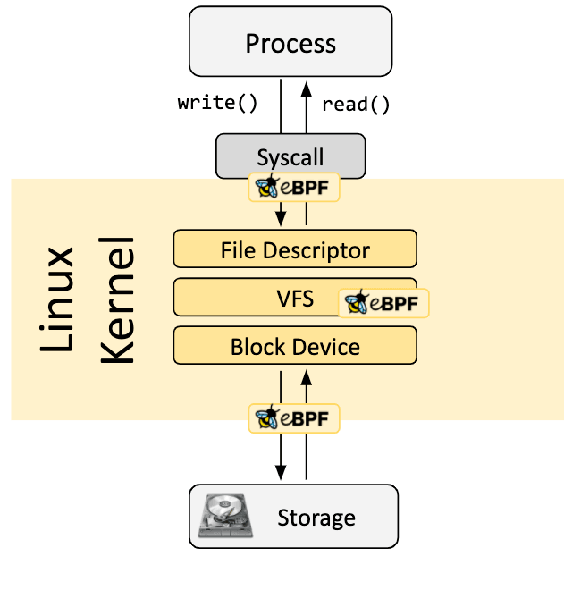
What is eBPF?
“eBPF is a [..] technology [..] that can run sandboxed programs in a privileged context such as the operating system kernel”^1

Slide 10
eBPF program type
BPF_PROG_TYPE_LSM are eBPF programs that can attach to LSM (Linux Security Module) hooks.
lsm/file_open

Slide 11
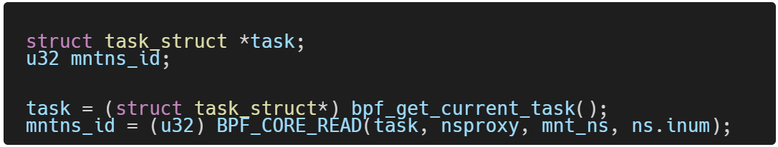
eBPF & task filtering
We load our eBPF program
We pass the mount namespace of the container to our eBPF program
For every task we receive we can access the mount namespace

Slide 12
Sending data from eBPF to user space
eBPF program resolve and determine absolute path of each accessed file
BPF_MAP_TYPE_RINGBUF
User program subscribe and save events to a file

Slide 13
Demo time

Slide 14

Thanks you
Project repository https://github.com/axel7083/oci-hook-lsm-file-open

Slide 15
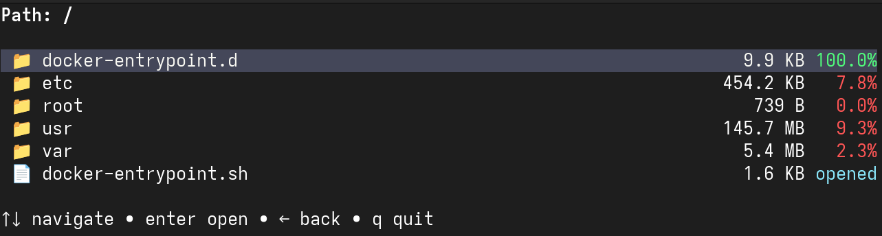
BACKUP (offline)

Slide 16
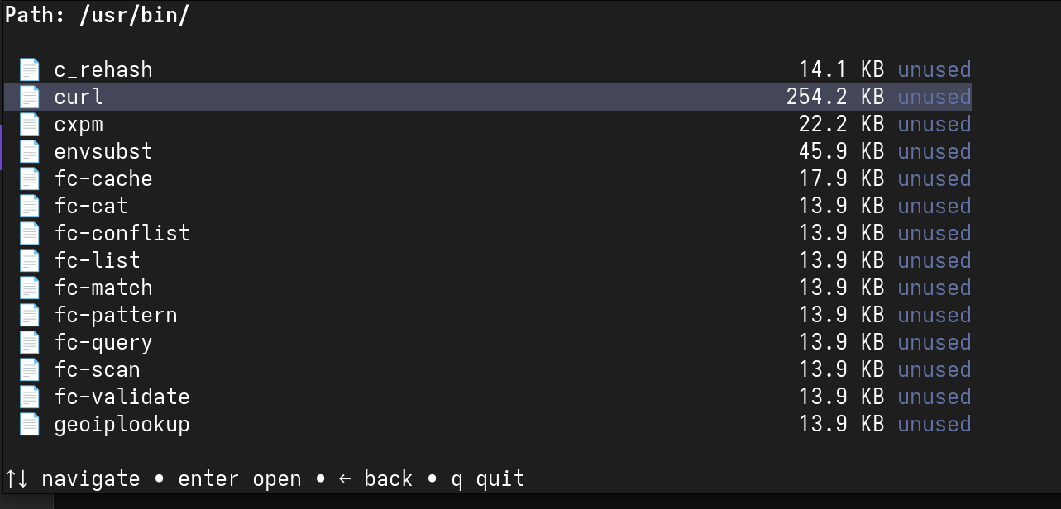
BACKUP (offline)

